Slide 1

Making Compliance Fun
Nathen Harvey

Slide 2
Hey, Nathen! Stream this meetup!
https://chef.zoom.us/j/509104664

Slide 3


Nathen Harvey
VP, Community Development at Chef
Co-host of the Food Fight Show Podcast
Occasional farmer – http://ei.chef.io
Love eggs – http://eggs.chef.io
#hugops – http://hugops.chef.io
@nathenharvey
nharvey@chef.io

Slide 4
Dev
QA
Stage
Prod
Notes:
I’m an application developer! When I build apps, they go through various stages to get to my production environment.

Slide 5
Notes:
I use Chef to manage my Infrastructure as code. I have fully automated the provisioning and maintenance of my environment.

Slide 6
Demo
See the running application
Review the development environment’s configuration
Review the cookbook that creates the site
Check out the open issues, let’s resolve some of those
https://github.com/nathenharvey/la_chef_meetup
Notes:
Look around the development environment.
Browser
.kitchen.yml
Cookbook

Slide 7

Notes:
I heard we were going to be audited. The auditor showed up and wanted to audit our environment.
I was a little nervous also self-assured. I was managing my infrastructure on AWS, everything is automated with Chef, how bad could it be.

Slide 8

Notes:
The auditor handed me a list of controls to verify.

Slide 9
SSH Control
SSH supports two different protocol versions. The original version, SSHv1, was subject to a number of security issues. Please use SSHv2 instead to avoid these.

Slide 10
Dev
QA
Stage
Prod
Notes:
This took forever…but once it was done I took solace in the fact that the auditors wouldn’t return for at least another six months. We could get back to our normal development process.

Slide 11
Dev
QA
Stage
Security Review
Prod
Notes:
“Not so fast!” said our security team. We had to introduce a Security Review phase to our delivery.

Slide 12
Notes:
This is how I think of “security reviews” – they slow down the flow and change backs up. The more changes back up, the more we need to “expedite” or “force” things through the dam in order to satisfy LoB needs. Which leads to…

Slide 13
Dev
QA
Stage
Prod

Slide 14
Dev
QA
Stage
Prod
"Scanning"
Notes:
Ok, so we still need to assure ourselves that things are "secure", right? So what we do is replace this security 'gate" with "scanning"
At some later date
Not with the same cadence as we're flowing changes through the system
Usually only when the auditors are on site
Which is why the sustainability is low – same thing as mentioned in the PCI report from Verizon

Slide 15
InSpec is compliance as code – a human-readable language for automating the continuous testing and compliance auditing of your entire infrastructure.

Slide 16
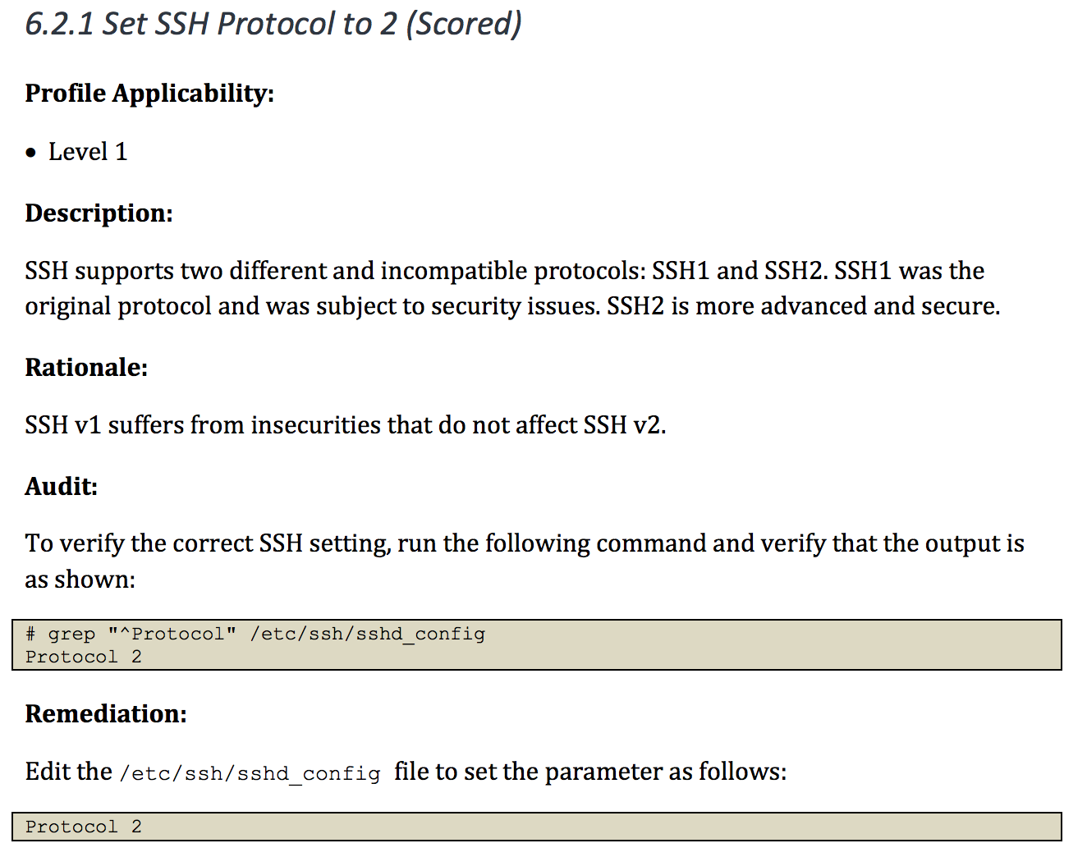
Mapping Compliance Document to InSpec
control 'ssh-6.2.1' do
title 'Set SSH Protocol to 2'
end

Slide 17
Mapping Compliance Document to InSpec
control 'ssh-6.2.1' do
title 'Set SSH Protocol to 2'
desc "
SSH supports two different ...
"
end

Slide 18
Mapping Compliance Document to InSpec
control 'ssh-6.2.1' do
title 'Set SSH Protocol to 2'
desc "
SSH supports two different ...
"
describe sshd_config do
its('Protocol') { should cmp('2') }
end
end

Slide 19
Mapping Compliance Document to InSpec
control 'ssh-6.2.1' do
impact 1.0
title 'Set SSH Protocol to 2'
desc "
SSH supports two different ...
"
describe sshd_config do
its('Protocol') { should cmp('2') }
end
end

Slide 20
Run Locally
$ inspec exec ssh-621.rb
✔ ssh-6.2.1: Set SSH Protocol to 2
✔ SSH Configuration Protocol should eq "2"
Profile Summary: 1 successful, 0 failures, 0 skipped

Slide 21
Run Remote via ssh
$ inspec exec ssh-621.rb –i my.pem –t ssh://someremotehost
✔ ssh-6.2.1: Set SSH Protocol to 2
✔ SSH Configuration Protocol should eq "2"
Profile Summary: 1 successful, 0 failures, 0 skipped

Slide 22
Run Remote via WinRM
$ inspec exec ssh-621.rb –t winrm://Admin@someremotehost
✔ ssh-6.2.1: Set SSH Protocol to 2
✔ SSH Configuration Protocol should eq "2"
Profile Summary: 1 successful, 0 failures, 0 skipped

Slide 23
Test a Docker Container
$ inspec exec ssh-621.rb –t docker://8eb7760bd9db
Target: docker://8eb7760bd9db046cfc826f36a6997b02a1cd884684870b78cede0ab03b62571a
✔ ssh-6.2.1: Set SSH Protocol to 2
✔ SSH Configuration Protocol should eq "2"
Profile Summary: 1 successful, 0 failures, 0 skipped

Slide 24
Stand Alone Usage
describe sshd_config do
its('Protocol') { should cmp 2 }
end
$ inspec exec test.rb
$ inspec exec test.rb -i vagrant.key -t ssh://root@172.17.0.1:11022
$ inspec exec test.rb -t winrm://Admin@192.168.1.2 --password super
$ inspec exec test.rb -t docker://3cc8837bb6a8

Slide 25



InSpec
Mechanisms for Policy Definitions
Profile Inheritance
Attributes
Custom Resources
Windows Support
Windows 2016 / Nano Support
Windows-specific Resources
PowerShell remoting protocol with NTLM support
Native Packages
Windows
macOS
Redhat & Ubuntu
Remote and agent-based execution
Custom sudo commands
more ssh options
Patch Management
windows-patch-benchmark (dev-sec.io)
linux-patch-benchmark (dev-sec.io)
Chef Ecosystem
Included in ChefDK package
Kitchen support
audit cookbook

Slide 26



InSpec Profiles
OS Hardening Profile
SSH Hardening Profile
Linux Patch Profile
Windows Patch Profile

Slide 27

InSpec Profiles
OS Hardening Profile
SSH Hardening Profile
Linux Patch Profile
Windows Patch Profile

Slide 28
InSpec Profiles
include_controls 'os-hardening' do
skip_control 'os-06'
control 'os-02' do
impact 0.7
end
end
include_controls 'ssh-hardening'

Slide 29
Demo
Apply the compliance profile - https://github.com/nathenharvey/acme-inspec-profile/
Remediate the issues with cookbooks from the Supermarket

Slide 30
InSpec is compliance as code – a human-readable language for automating the continuous testing and compliance auditing of your entire infrastructure.

Slide 31





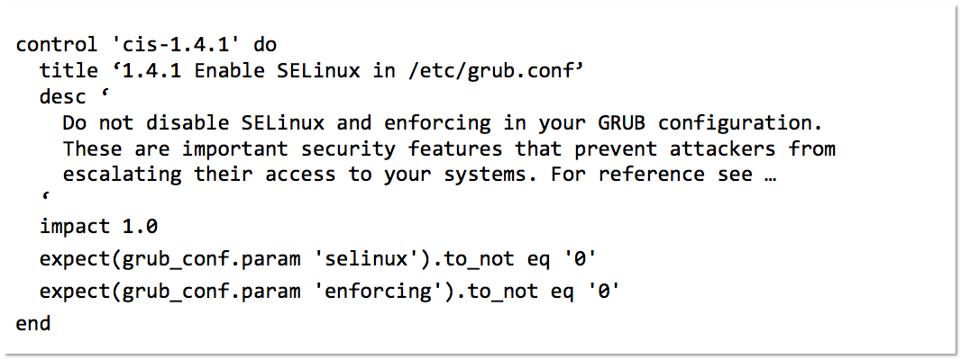

InSpec: Turn security and compliance into code
Part of a process of continuous compliance
Translate compliance into Code
Clearly express statements of policy
Move risk to build/test from runtime
Find issues early
Write code quickly
Run code anywhere
Inspect machines, data and APIs
Scan for Compliance
Build & Test Locally
Build & Test CI/CD
Remediate
Verify
A simple example of an InSpec CIS rule
Notes:
Integrate compliance and security requirements into your automated deployment pipeline. The InSpec language lets you specify those requirements as code. When compliance is code, you can identify issues during development and not after the fact. Test large-scale environments while still moving at velocity.
Translate compliance into code. InSpec is an open-source testing framework with a human- and machine-readable language for specifying compliance, security and policy requirements. When compliance is expressed as code, you can integrate it into your deployment pipeline and automatically test for adherence to security policies.
Clearly express statements of policy. When compliance is code, rules are unambiguous and can be understood by everyone on the team. Developers know what standards they're expected to meet and auditors know exactly what is being tested. Replace spreadsheets filled with abstract descriptions with tangible tests that have a clear intent.
Find issues early. Automated compliance tests can start at the beginning of the development cycle. You'll detect any issues well before your code goes into production, when problems are expensive and time consuming to fix.
Write code quickly. The InSpec language includes a collection of resources that help you write audit controls quickly and easily. You can also create custom resources for your own particular situations.
Run code anywhere. InSpec code can run in multiple platforms. You can execute the same set of tests locally, with remote commands that use SSH or WinRM, or with external mechanisms such as the Docker API.
Inspect machines, data, and APIs. Knowing that your physical servers are in compliance is, of course, essential. But your applications rely on more than just server configurations. With InSpec, you can assess data in a database or inspect the configuration of virtual resources by using their API. For example, you can check security group settings on your IaaS infrastructure.
Compliance as Code
The speed and collaboration of DevOps for security & compliance
Security documents as executable code
Compliance is assured from the start of the development cycle
Security-focused framework
DSL that helps you get started writing audit controls quickly & easily
Inspec works the same way everywhere: locally, remotely, or executed via API
Tailored to the needs of security professionals
Flexible and extensible
Easily create custom resources, if needed
Create and share profiles for code reuse and modularity
Inspect machine state, data state, and API configurations

Slide 32
Available Resources
apache
apache_conf
apt
audit_policy
auditd_conf
auditd_rules
bash
bond
bridge
command
csv
directory
etc_group
file
gem
group
grub_conf
host
iis_site
inetd_conf
ini
interface
iptables
json
kernel_module
kernel_parameter
limits_conf
login_def
mount
mssql_session
mysql
mysql_conf
mysql_session
npm
ntp_conf
oneget
os
os_env
package
parse_config
passwd
pip
port
postgres
postgres_conf
postgres_session
powershell
processes
registry_key
security_policy
service
shadow
ssh_conf
ssl
user
vbscript
windows_feature
wmi
xinetd
yaml
yum

Slide 33
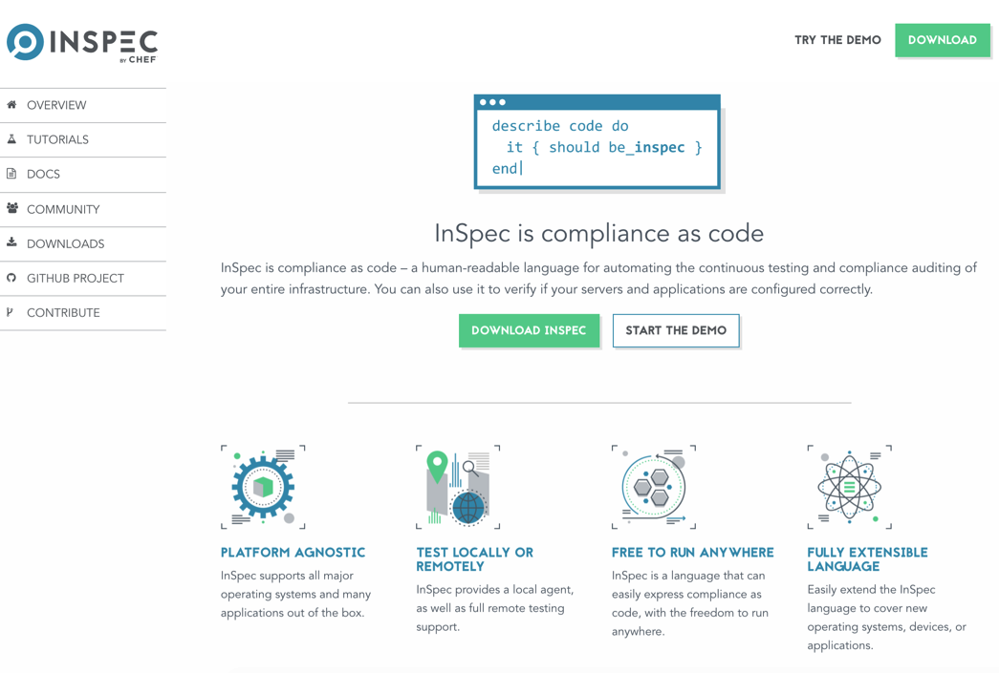
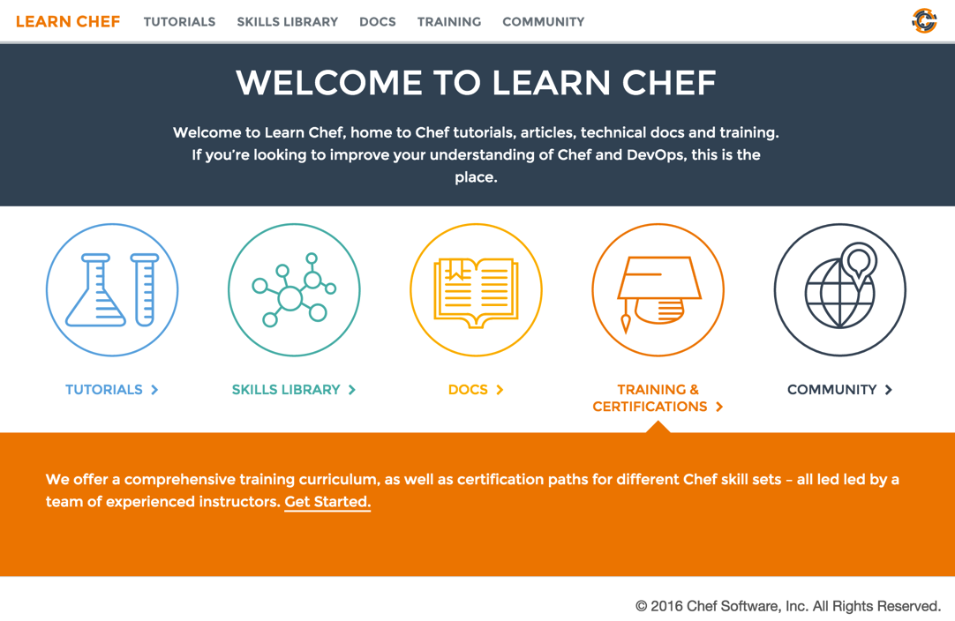
Further Resources
inspec.io
Hands on tutorials
Extensive documentation
Code examples
learn.chef.io
More tutorials about Compliance and Inspec

Slide 34



Chef Automate
Workflow
Visibility
Compliance
Infrastructure Automation
Application Automation
Compliance Automation

Slide 35
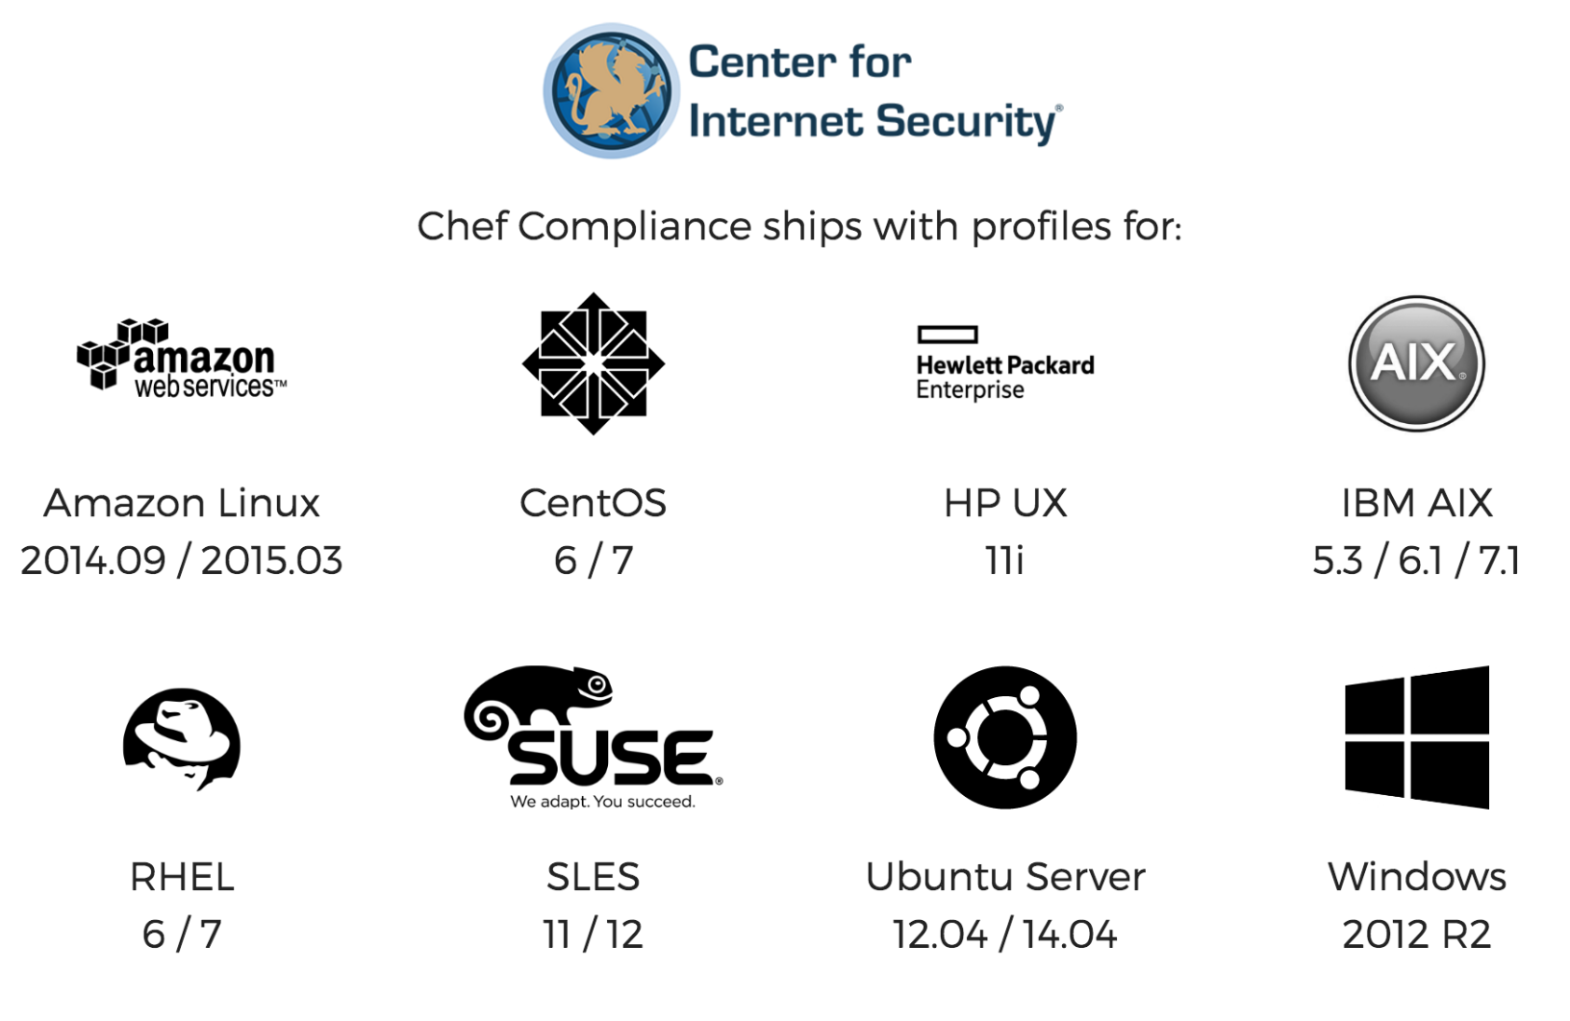
Chef Automate

Slide 36


Slide 37
Nathen Harvey
VP, Community Development at Chef
Co-host of the Food Fight Show Podcast
Occasional farmer – http://ei.chef.io
Love eggs – http://eggs.chef.io
#hugops – http://hugops.chef.io
@nathenharvey
nharvey@chef.io

